Slide 1
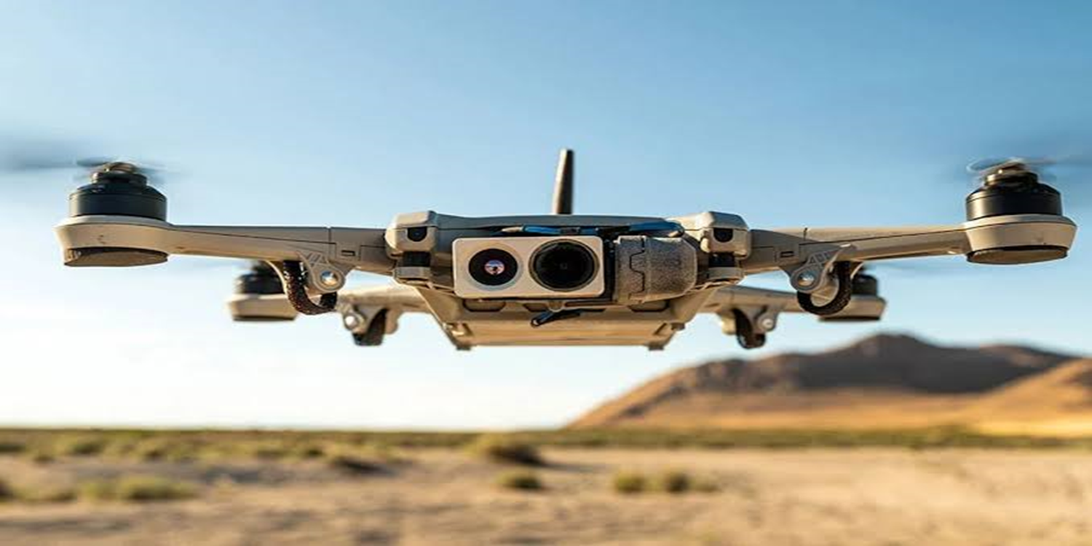
DRONE TECHNOLOGY DRONE ANATOMY & TERMINOLOGY

Slide 2
INTRODUCTION

Slide 3
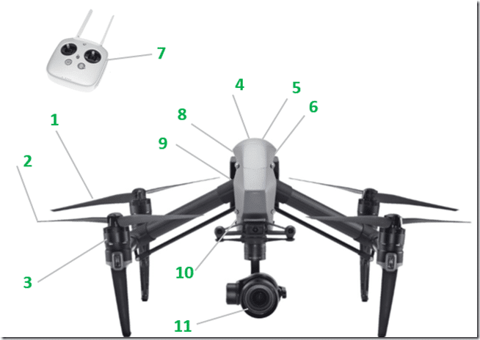
PHASE - I : COMPONENTS OF DRONE
Key
1. | PROPELLERS
2. | PROPELLERS
3. | BRUSHLESS MOTORS
4. | LANDING GEARS
5. | ESC
6. | FLIGHT CONTROLLER
7. | RADIO CONTROLLER
8. | TRANSMITTER
9. | GPS MODULE
10. | BATTERY
11. | CAMERA

Slide 4
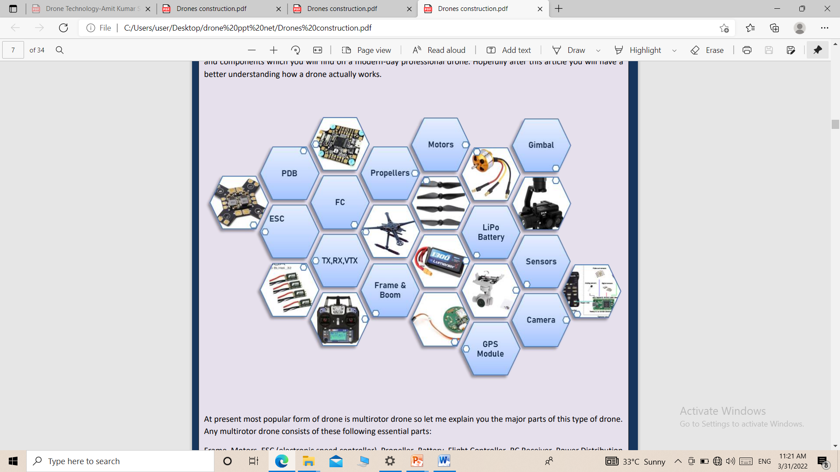
COMPONENTS OF DRONE

Slide 5


COMPONENTS OF DRONE
  Drone Frame.
  Motors.
  Electronic Speed Controller.
  Flight/Control Board.
  Propellers.
  Receiver.
  Gimbal.
  Radio Transmitter.
  Battery .
  Antenna.
  Camera.
  Landing Gears.

Slide 6
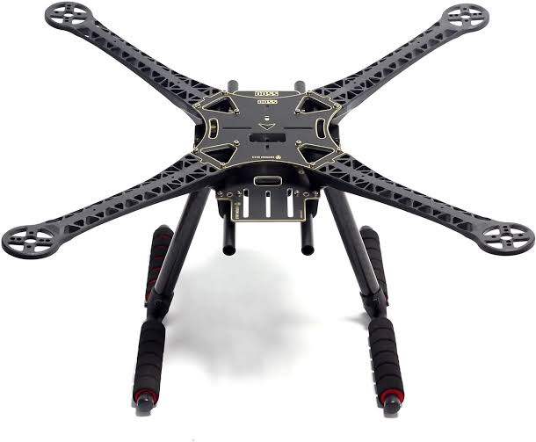
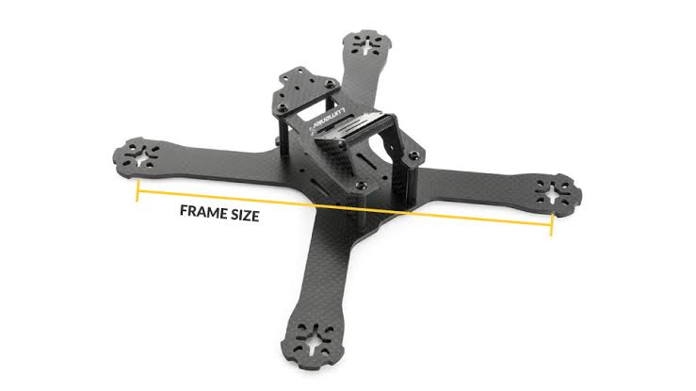
DRONE FRAME
  Frame ke ander hi drones ke sabhi chhotte parts ko fit kiye jate hain.
  Jo saman roop se drone ke centre of gravity ko various akar mein distribute karte hain.
  Frame alag-alag shapes & size mein avl hai.
  Amtaur par frame carbon fibre ka bana hota hai.

Slide 7
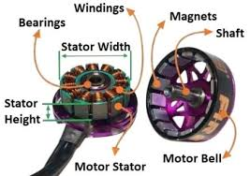
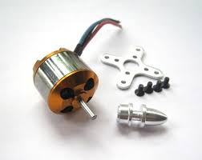
MOTORS
  Propeller’s ke rotation ke liye jaruri.
  Amtaur par propellers ki qty ke mutabiq hi motors ki qty hoti hai.
  Motors ko is parkar fit kiya jata hai, jis ko controller dawara asani se rotate kiya ja sake.
  Motors ke alag-alag parkar ke parameters jaise ki voltage, current, thrust, power, speed etc ko check karna jaruri hai.
  Brushless motors ka jaidatar istemal kiya jata hai.

Slide 8
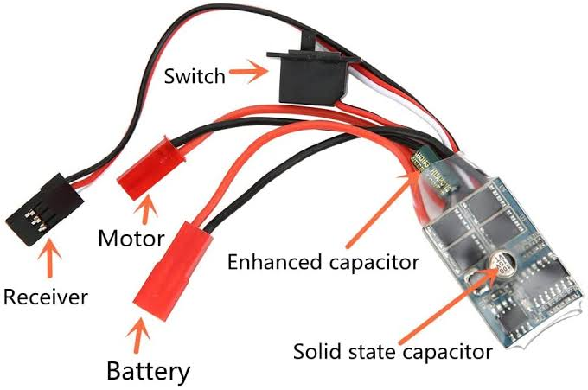
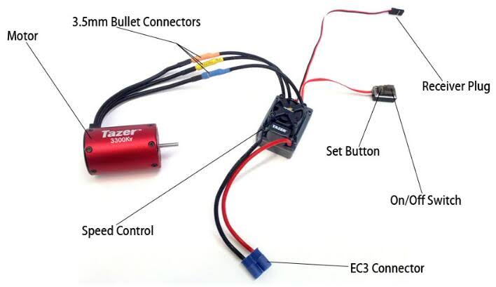
ELECTRONIC SPEED CONTROLLER
  Yeh ek electronic circuit hai, jo drone ke brain ke roop mein kaam karta hai.
  Yeh electric motor ki speed ko badalta hai aur motor ko chalane ke liye dc bty ko 3 phase ac mein convert karta hai.
  ESC drone ke size ko compact banane mein madad karta hai.

Slide 9
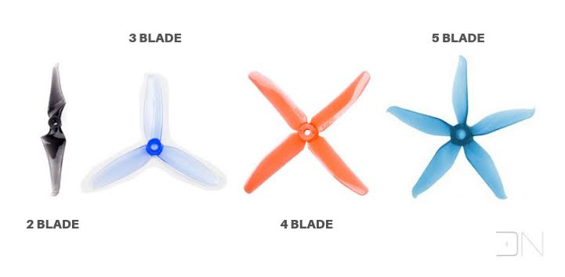
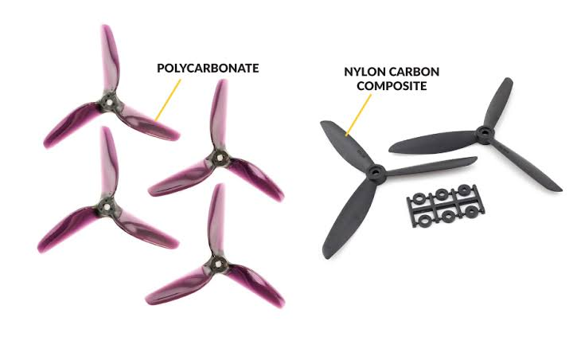
PROPELLERS
  Propellers amtaur par blade hote hain, jin ka kam hawa ke pressure mein difference paida karna hota hai.
  Jab propellers motion mein hote hai to je rotor ke upar aur neeche ke dabav mein antar paida karne wali hawa ko cut karte hain.
  Top side mein air ka pressure bottom side ki tulna mein kam hota hai, jis se drone asani se lift kar jata hai.
  Amtaur par je plastic ja carbon fibre ke banaye jate hain.

Slide 10
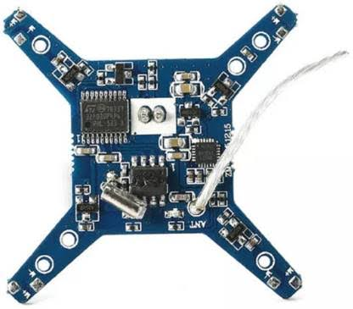
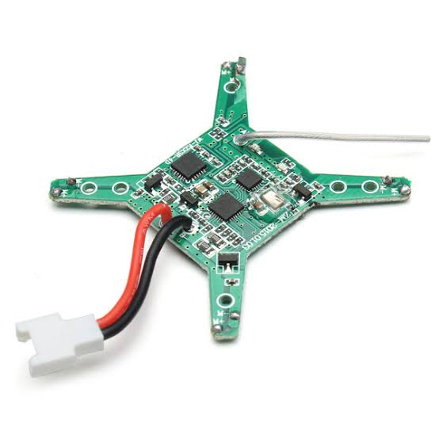
RECEIVER
  Yeh controller dawara bheje gaye radio signal ko receive karne wali ek unit hoti hai.
  Drone ko control karne ke liye minimum 4 channels ki rqmt hoti hai.

Slide 11
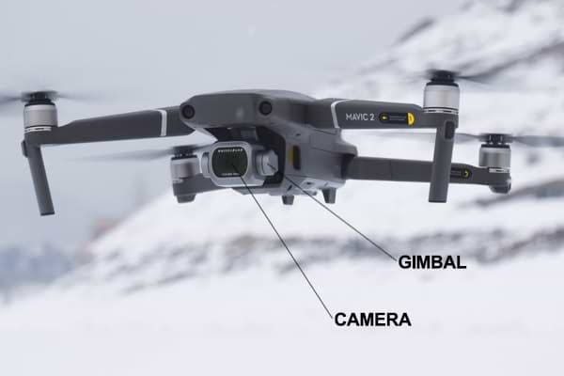
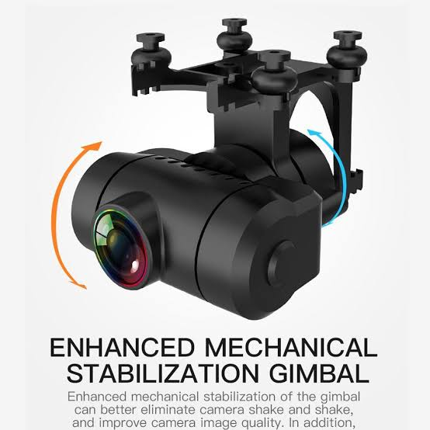
GIMBAL
  Gimbal ko pivot mount kiya jata hai, jo ki x,y,z axis par harkat kar sakta hai.
  Video recording ja photogrhapy ke dauran camera aur other sensors ko stable karne mein madad deta hai.

Slide 12
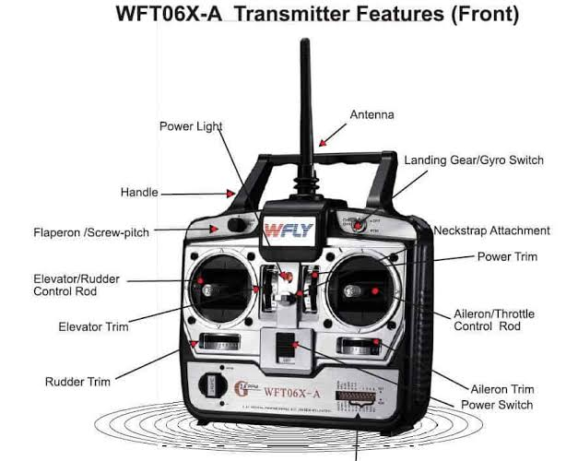
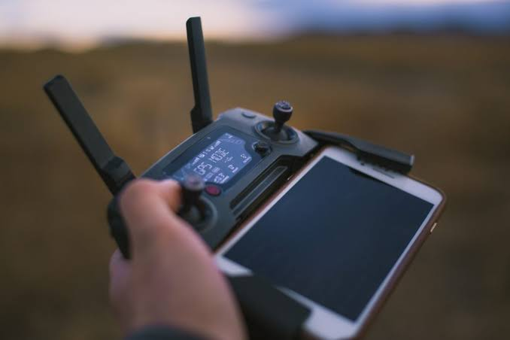
RADIO CONTROLLER
  Yeh ek channeled transmitter aur drone ke liye ek communicator ka kaam karta hai.
  Har channel mein ek special frequency hoti hai, jo drone ko ek nishchit gati mein chalane mein saksham hoti hai.
  Effective operation ke liye kam se kam drone ko 4 channels ki requirement hoti hai.

Slide 13
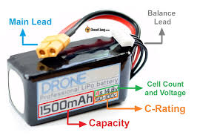
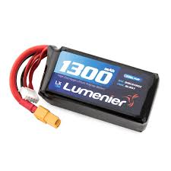
BATTERY
  Yeh drone ke power source ke roop mein kaam karti hai.
  Yeh frame ke ander lage all electronics parts ko power distribution cable ke throuh energy supply karti hai.
  Amtaur par drones ke ander lithium polymer batteries ka istemal kiya jata hai.

Slide 14
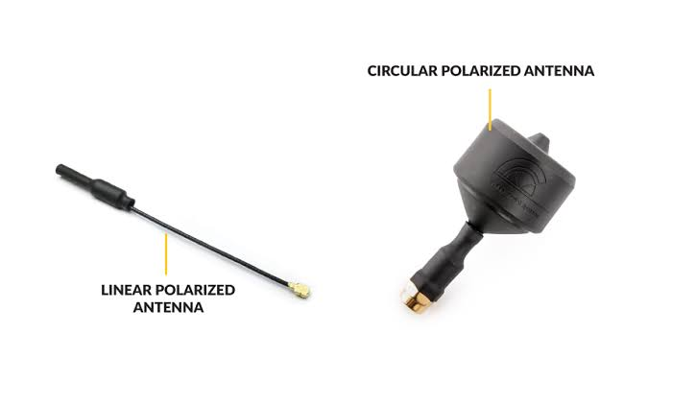
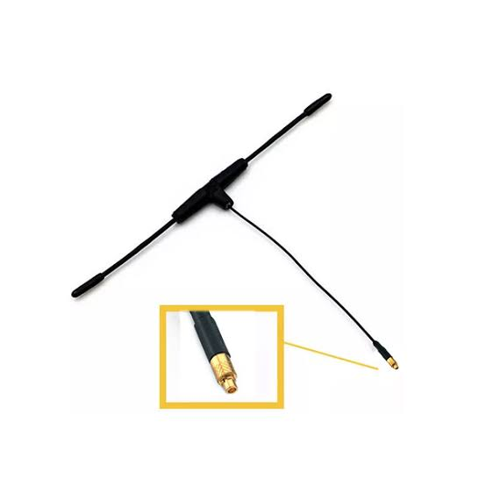
ANTENNA
  Yeh drones ke legs ke ander paye jate hai.
  Yeh drone se jankari lekar controller ko pass karne ka responsible hota hai.
  Yeh controller ko drone ki direction ke bare mein bhi jankari deta hai.

Slide 15
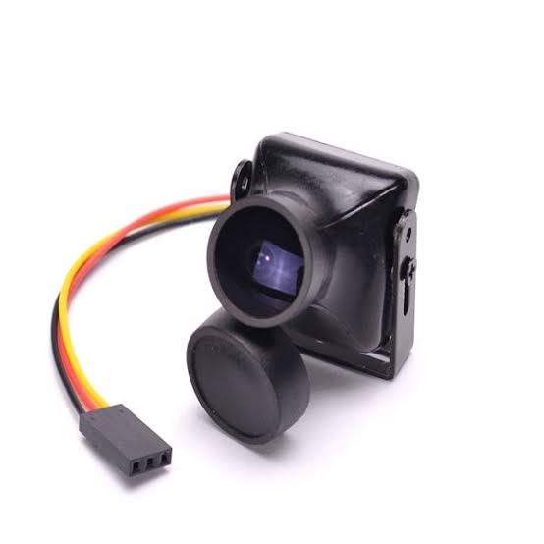
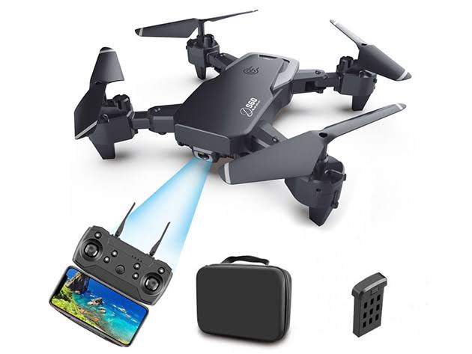
CAMERA
  Photographs aur video recording ke liye istemal kiya jata hai.
  Modern drones all in one hote hain, jo ki integrated gimbal aur camera ke sath ate hai.

Slide 16
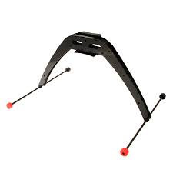
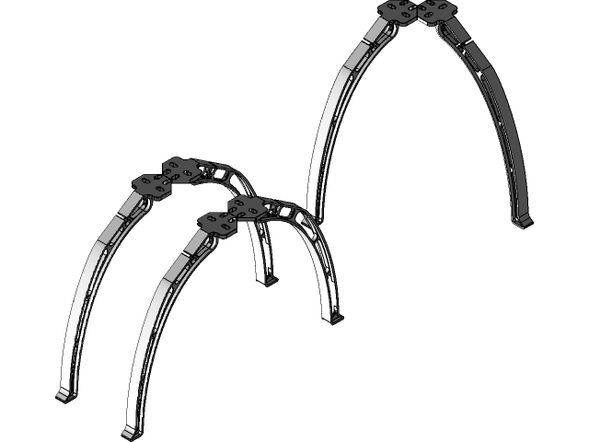
LANDING GEARS
  Yeh drones ko asani se land karne mein madad dete hai.
  Yeh 2 types ke hote hain.
    Fixed.
    Retractable.

Slide 17
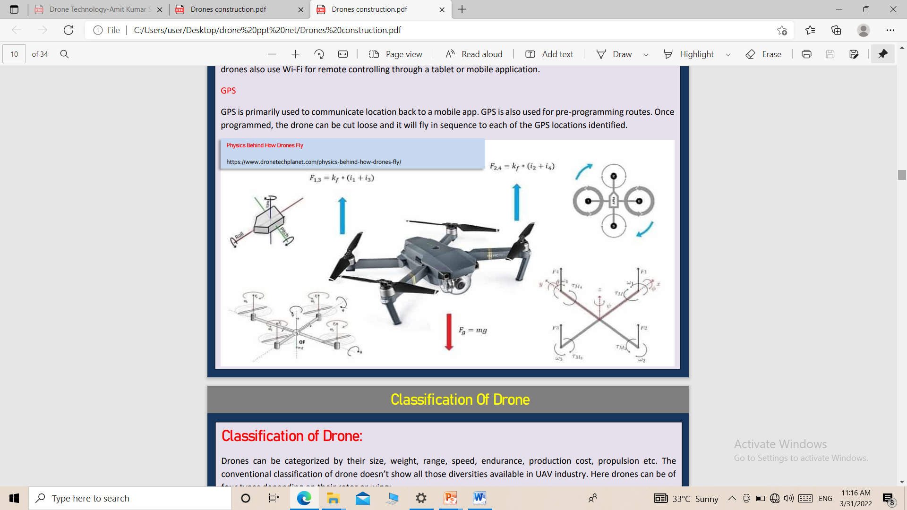
PHASE – II : AERODYNAMICS & PRINCIPLES
OF FLYING

Slide 18
HOW DO DRONES FLY?
Two rotors clockwise rotaion karte hai, baki 2 rotors anti-clockwise rotate hote hai.
Anti-clockwise harkat karne wale rotors drone ko balance karne mein madad dete hai. agar sabhi rotror ek hi direction mein rotate karenge to is ka matlab net torque paida hoga aur pura drone hi ghumna shuru kar dega.
Jab rotor ek sath rotate karte hain to hawa ko neeche ki taraf push karte hai aur hawa rotor ko upar ki taraf push karti hai. jab rotors speed se rotate karte hai to drone upar ki taraf uthta hai, jab rotors slow speed mein rotate karte hai to drone jamin ki taraf aata hai.

Slide 19
JAI HIND

